Slide 1
Hybrid Cloud Design White boarding - Session #1A Feb 03, 2017

Slide 2
Discussion Topics
Business Requirements
Terms & Definitions
High Level Model
Design Guidelines & Principles
Target State Model Building Blocks
Conceptual Model
Technical Reference Model

Slide 3
Corporate Business Directives
Directive : Message from “Greg D. Carmichael” CEO, Fifth Third Bank
BD -1
“Team’s job is to create the infrastructure that will provide quality, speed, security, and convenience to our customers”
BD -2
“We are dealing with people’s finances, so we had to give our customers the confidence, through advanced technologies”

Slide 4
Business Goals
BG -1
To enable “Cloud-First” as an IT culture and promote IT Service as an enabler for the Business – Refer BD1
BG -2
To establish “IT-as-a-service” capability within the bank by enabling “Hybrid Cloud Services” that drives agility, efficiency, and time to market while keeping IT costs under control – Refer BD1, BD2

Slide 5
Business Principles
BP -1 : Value Chain
To enable Business functions approach “Hybrid-Cloud” services and operations in a responsive. Flexible manner with less complexity so as to increase the business agility
BP -2 : Finance
To enable a “Hybrid Cloud” that support the business function to pay for what’s being used and not being compelled to pay for unused IT services – Refer BD2
BP -3 : Business Environment
To enable Flexibility and Scalability of the Hybrid Cloud Services so as to scale with the driving needs of the Business
BP -4 : Stakeholder
To enable Hybrid Cloud Services that builds Brand reputation for both Internal and External stakeholders
BP -5 : Compliance
To be aligned with regulatory needs, enable Security and compliance built in

Slide 6
Hybrid Cloud – Business Needs
Agility
Enable business and IT customers to respond faster to market
Cost
Op-Ex reduction and improvement in Operational Efficiency
Transparency in IT consumption and billing for customers
Flexibility
Flexibility to customers in terms of ease of use via Service Catalog and Self Service
Elasticity
Proactively address capacity requirements based on business seasonality
Fit for Purpose

Slide 7
Hybrid Cloud – Functional Needs
Topic Area | Functional Principles
Service Consumer | To enable IT as a Commodity service by using SAAS and PAAS as first approach To enable Service Catalog for standard service deliveries. This catalog needs to be expanded as more standards are identified through the Cloud Transformation journey Enable Dashboard to support quality assurance audit and value realization techniques To enable dashboards with detailed, real-time data for business stakeholders To enable real-time, fine-grained IT cost assessment on a program, project or LOB basis. To enable least privilege on all accounts as applicable only to meet the business function To secure the keys used for system user authentication
Organization | To Enable Finance forecast that can support evergreen or incremental funding approach that ties merit-based funding to incremental solution delivery rather than annual/multi-year funding paradigm To enable cost view of Cloud Services to gain better insight into derived business value To Integrate Developer, Operations and Security team objectifies and Job functions To enable embedded operating model where a multidisciplinary team is both responsible and accountable for the full lifecycle of the product delivered.
Responsibility of Content | To enable and automate risk assessment and compliance on the Hybrid Cloud Environment, components, process and operating model To enable strong Authentication as part of protection scheme for all actors in the account
System Behavior | To enable real-time monitoring capability of Cloud Services to control value and costs, and to inform reprioritization efforts To enable billing data that promotes a charge-back or show-back approach to allocation To mandate the usage of Tagging based services on all possible Cloud Resources at the time of deployment To enable business outcome metrics as exit criteria for every submission into the catalog To enable clear roles, responsibilities, and authority for all cloud functions to achieve the objectives that have been defined within the IT strategy
Information maintained by the System | To enable business process aligned tagging and a structured naming convention To define data security and retention policies To enable Monitoring and logging strategy for the services and Business dashboards for consuming the log

Slide 8
Hybrid Cloud – Functional Needs
Topic Area | Functional Principles
Accuracy | To deliver Accurate information for the Business Sponsors and stakeholders
Performance | To enable services that can scale horizontally and vertically. Services should have option to scale as performance demand placed by business To enable a system that can suffice the business user requirements in terms of performance
Security | To enable integration capabilities for Vulnerability management on Cloud services To enable control framework for Cloud Services to meet the Security Standards To enable Security as a Code Culture that can allow to Deploy and validate Security To enable a culture of Security ownership for application teams through system of records
Privacy | To maintain Data privacy at all layers of the Cloud services
Human System Interfaces | To enable centralized contact management for the Stakeholders involved and configuration management for the services involved To enable Automated Deployment Process for Cloud Services that improves consistency, reduces the impact of Human error, and introduces portability
Information Exchanges | To enable exposed API endpoints where possible for easy discovery, integration, and reuse
Scalability | To institutionalize a scalable, service-oriented architecture (SOA) approach to separate concerns and to enable integration of reusable services and limit the amount of code maintained
Availability | To Deliver the identified BCRA needs based on business demands
Maintainability | To enable and enforce a lifecycle approach to product creation and support To enable Config. Management Platform and ensure governance and control of the Environment

Slide 9
Hybrid Cloud - Design Guidelines & Principles
Green Field Approach & Cloud First
Overcome current environment constraints; Cloud first; Minimize footprint
Automation First & Automate All & End to End Automation
Automation Framework for every new Service on-boarding
All platform services to be exposed as ‘smart endpoints’ for automation
Enable zero manual touch Automation model for end to end Service delivery
Consumption based commercial model
Continuous metering and monitoring of all services to show-back and chargeback service consumption
Scalable, Extensible and Interoperable
Design framework based on Open Standards
Adoption of modular, decoupled and independently scalable services
Simplified and Compliant
Simplified Process Framework with minimization of manual controls
Adherence to Global Security, Compliance & Regulatory Standards

Slide 10
Hybrid Cloud – Terms & Definitions | Ref: NIST 800-145
Term | Description
Cloud Computing | Cloud computing is a model for enabling ubiquitous, convenient, on-demand network access to a shared pool of configurable computing resources (e.g., networks, servers, storage, applications, and services) that can be rapidly provisioned and released with minimal management effort or service provider interaction
Essential Characteristics of Cloud | On-demand Self Service Broad Network Access Resource Pooling Rapid Elasticity Measured Service
Service Models | SaaS - The capability provided to the consumer is to use the provider’s applications running on a cloud infrastructure PaaS - The capability provided to the consumer is to deploy onto the cloud infrastructure consumer-created or acquired applications created using programming languages, libraries, services, and tools supported by the provider IaaS - The capability provided to the consumer is to provision processing, storage, networks, and other fundamental computing resources where the consumer is able to deploy and run arbitrary software, which can include operating systems and applications
Deployment Models | Private Cloud - The cloud infrastructure is provisioned for exclusive use by a single organization comprising multiple consumers (e.g., business units); usually exists on-premises of the organization Public Cloud - The cloud infrastructure is provisioned for open use by the general public. It may be owned, managed, and operated by a 3rd party; exists on premises of the cloud provider Hybrid Cloud - The cloud infrastructure is a composition of two or more distinct cloud infrastructures (private or public) that remain unique entities, but are bound together by standardized or proprietary technology that enables data and application portability

Slide 11

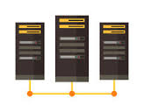

Hybrid Cloud – High Level Model
Public Cloud Services (IaaS, PaaS)
Hosted SaaS Providers
Hosted PaaS Providers
On-Premises
Private Cloud
(IaaS, IaaS+)
Legacy , Backend
Traditional Datacenter

Slide 12
Hybrid Cloud Services – Service Model
What is a Hybrid Cloud Service?
It is a service natively offered by the hybrid cloud platform which will be delivered to the consumer in an end to end automatic fulfillment model and its consumption will be measured on a well defined resource unit-scale for charging the customer proportional to the quantity of consumption
What are the types of Hybrid Cloud Service?
Technology Service
A type of service offered by the hybrid cloud platform as an abstraction of the underlying technologies and measured on a specific ‘Resource unit’ model; for e.g., Compute Service
Operational Service
A type of service offered by the hybrid cloud platform for maintaining and operating the hybrid cloud resource at particular Service level and measured on a specific ‘resource unit’ model; for e.g., Incident management as a Service
Bundled Service
A type of service which is a meaningful user consumable service which is basically a bundle of Technology and Operational Services; for e.g., a Production Windows Virtual Server
What are the Service Consumption types?
One Time
A service consumed as a single unit at every service request and charged for every single service consumption; for e.g., a Change Request
Continuous Consumption
A service consumed over a period of time and measured by units consumed over the period and charged at a particular frequency; for e.g., a Production Windows Virtual Server

Slide 13
Hybrid Cloud Services -Target State Conceptual Model
Monitoring & Alerting Toolset
Cloud Services Catalog
Workflow Orchestrator
Public Cloud Native Automation
Chargeback & Metering Tools
Security & Compliance Tools
MGMT LAYER
Logging & Analytics
Platform
IT Service Management Tools
Configuration Automation
Release Management Tools
Capacity Tools
Reporting & Dashboards
Hybrid Cloud - Technology Services
Hybrid Cloud - Operational Services
Compute (Server)
Compute (VDI Desktop)
Compute
(Containers)
Platform Software
Service Request Management
Incident & Problem Management
Change Management
Full Stack Application
DNS/
IPAM
NACLs
Load Balancer
SERVICES LAYER
Discovery & CMDB
Demand & Capacity Management
Image & Patch Management
STD. RUs
STD. RUs
Block Storage
File Storage
Object Storage
Backup & Archival
Network QoS.
API Gateway
Databases
Id & AM
Application Release Management
Application Operations
Monitoring & Event Management
On Premises Private Cloud
3rd Party Provider (Virtual Private Cloud)
Virtualized Private Cloud Layer (Compute, Network, Storage)
Private Cloud
‘Hosted PaaS’
Software defined Services Layer
3rd Party Hosted SaaS
Apps.
Physical x86 Compute
Virtualized (Branded) x86 Compute
Virtualized
( Open Source)
Software defined Platform Layer
TECHNOLOGY LAYER
Branded H/W
Commodity
H/W
Hyper Converged
Compute +
Storage
Public Cloud Software Defined
Infra Layer
Hyper Converged
Compute +
Storage
Compute
Network
Storage
Private Cloud Storage Layer (Enterprise Storage)
AWS
Microsoft Azure
Block Storage
File Storage

Slide 14
Target State Services – Conceptual Consumption Model
Technology Services
Compute (Server)
Block Storage
DNS & IPAM
Continuous Consumption Item
(Continuously charged to business at a defined frequency until end of consumption)
Backup
Monitor
Network QOS
Operational
Services
Incident
Problem
Patching
Discovery & CMDB
Event Mgmt.
BCP & DR Service
Service Catalog Item
e.g. A Production Windows Virtual Server on Azure
Service Request
Open Network ACLs
Dev. Database Refresh
Deploy new Stack in Dev.
1- Time Consumption Item
(Charged to Business only one time)
CLOUD SERVICES CATALOG
Server Services
Database Services
Change Request
Modify Webserver Configuration
Database Upgrade
Deploy Code
Id & AM Services
API Mgt. Services
Caching Services
Security Services
Network
Services
Web - App Services

Slide 15
Hybrid Cloud Services – Service Definition Framework
Service Design Template | Service Catalog Item Attributes
New Service Design Model (Part-A)
Service Group
Service Category
Service Offering Name
Service Unique Identifier
Service Description
High Level Service Lifecycle Document
Low Level Service Lifecycle Document
New Service Design Model (Part –B)
Service Unit (RU) ID
Service Metering Rule
SLA & KPI
Service Owner
Service Provider
Per RU Price Per Metering Frequency
Last Updated Date

Slide 16
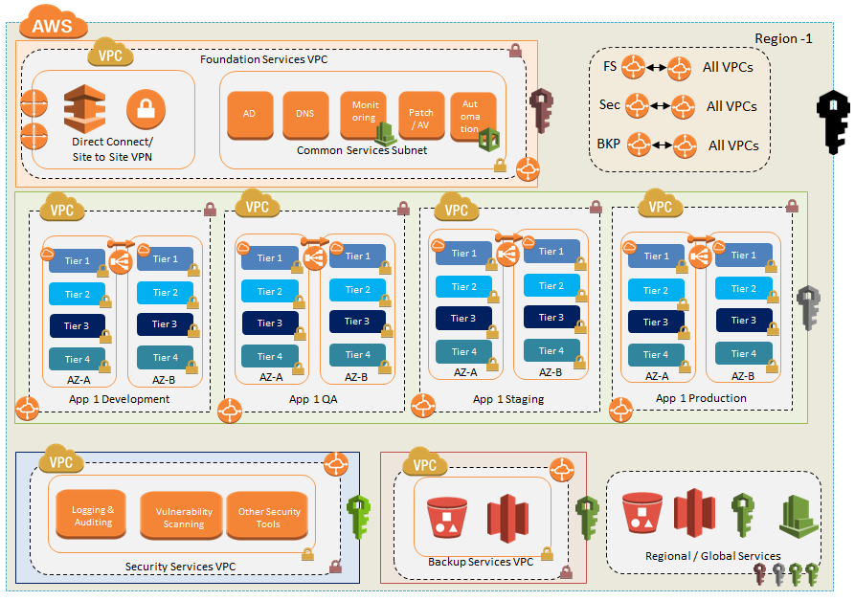

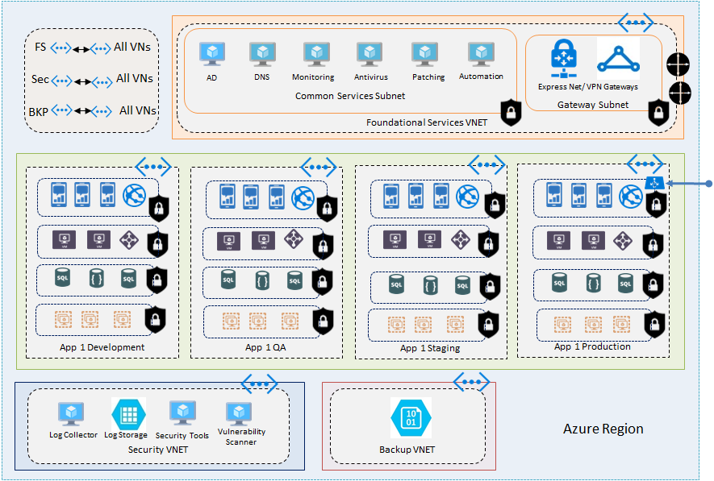
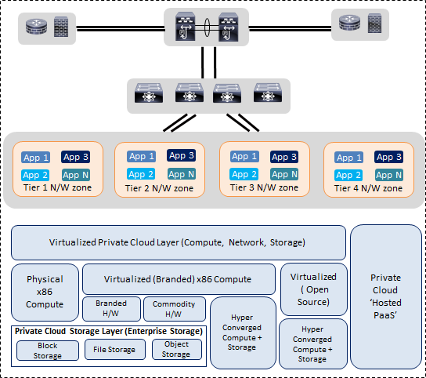
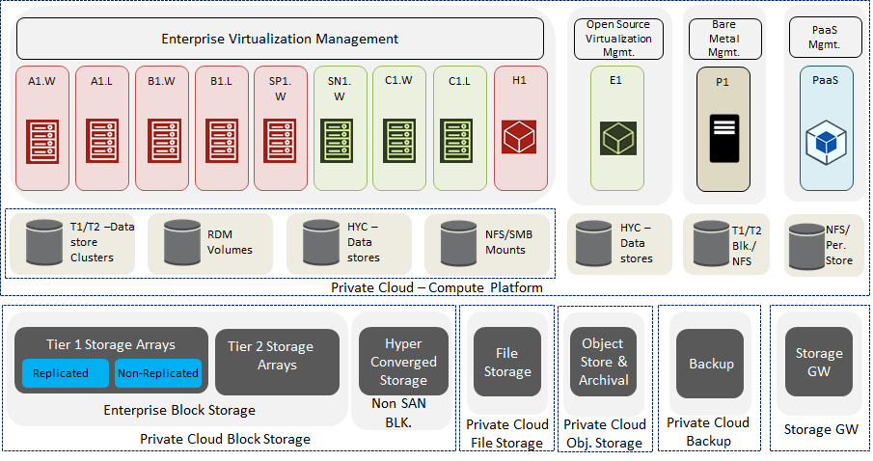
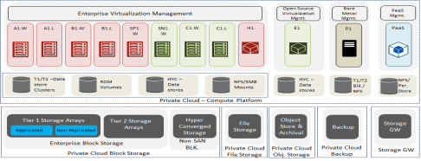
Target State Technical Reference Model
Business Partners
3rd Party
SaaS Platform
3rd Party Hosted
PaaS
Internet
(VPN)
On Premises Private
Cloud
FLOKY
(Prod)
AWS
Azure
AWS - Direct Connect/
VPN
10G
10G
Azure – Express Route/
VPN
GRAMI
(non prod, DR)

Slide 17
Thank you!

